Slide 1
CHAPTER 3: SYSTEMS AND SOFTWARE DESIGN
INTRODUCTION
D
PROJECT MANAGEMENT SYSTEMS
CHAPTER 2: ANALYSIS & REQUIREMENT SPECIFICATION
C
Activity Diagram
B
PMS MASTER
A
Conclusion
GROUP 1
Class Diagram
LECTURER: NGUYỄN NHẤT HẢI
Entity Relationship Diagram (ERD)
Use-case Diagram
MEMBER: Vũ Quang Hiệp Nguyễn Trọng An Lê Hoàng Sơn
UI Design – Prototyping

Slide 2

INTRODUCTION
PMS MASTER
A

Slide 3
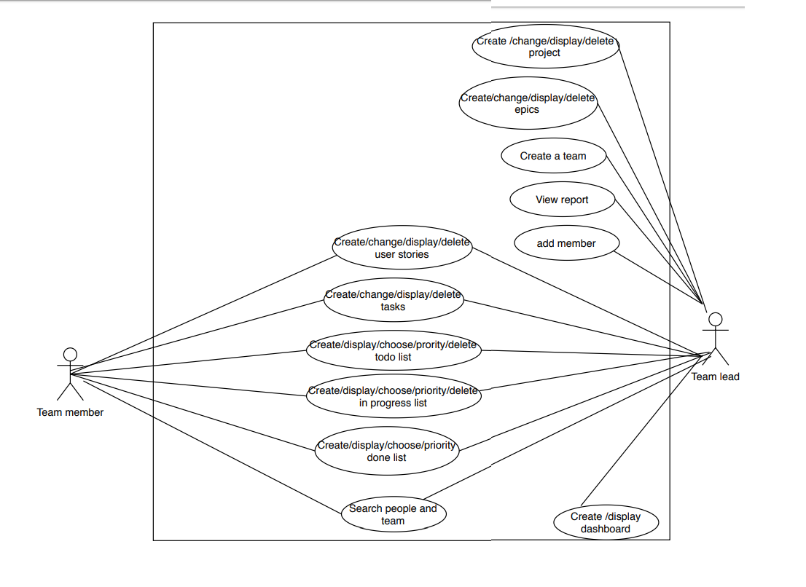
CHAPTER 2: ANALYSIS & REQUIREMENT SPECIFICATION
Use-case Diagram
B

Slide 4
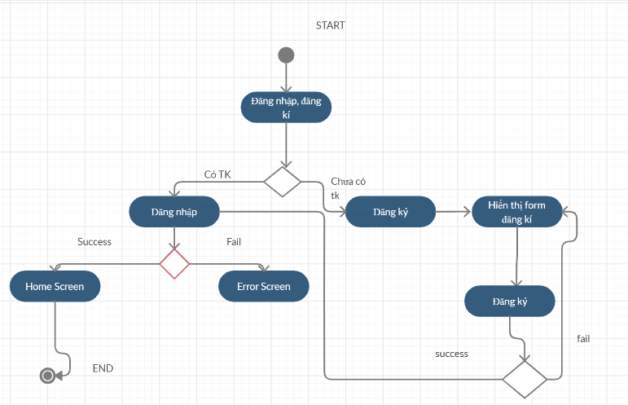
CHAPTER 3: RESULT OF TRAINNING COURSE
Activity Diagram
Login Diagram
C

Slide 5
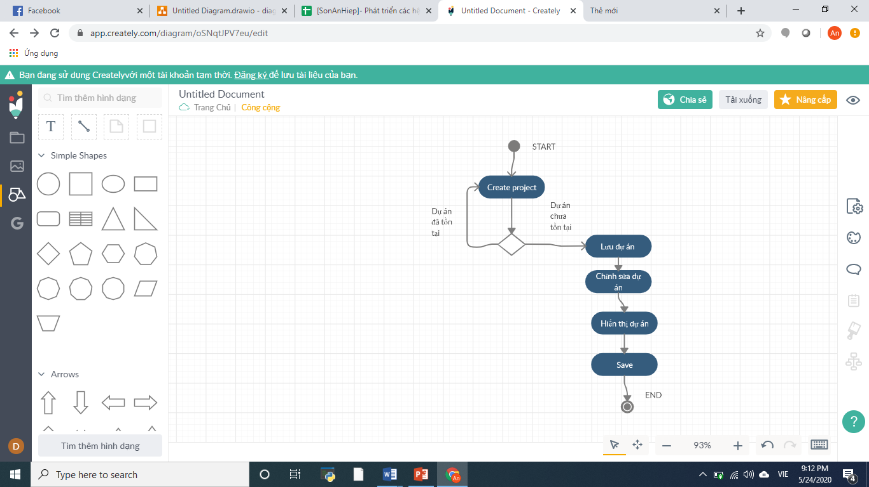
CHAPTER 3: RESULT OF TRAINNING COURSE
Activity Diagram
Creating Project Diagram
C

Slide 6
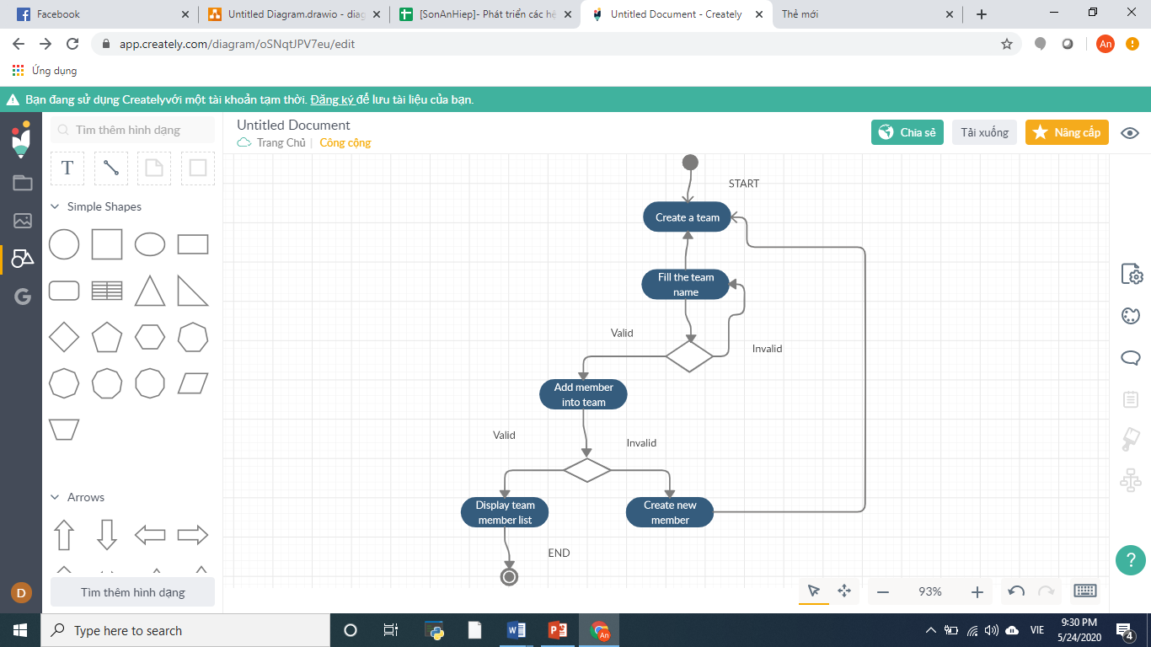
CHAPTER 3: RESULT OF TRAINNING COURSE
Activity Diagram
Creating a team, adding member activity diagram
C

Slide 7
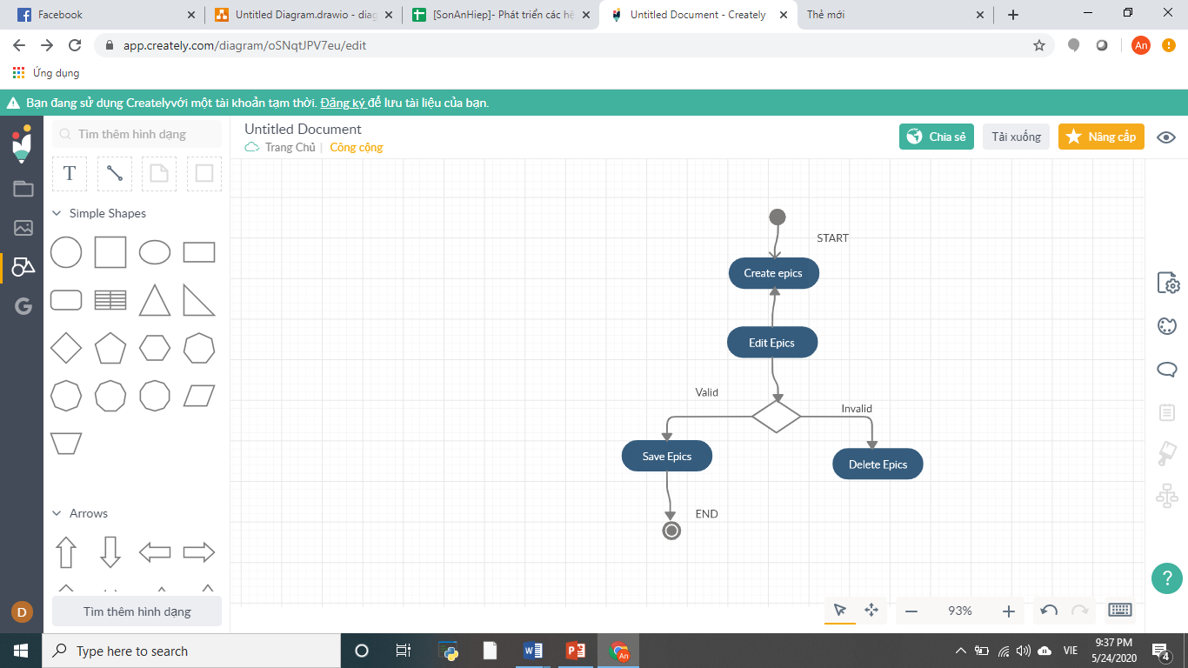
CHAPTER 3: RESULT OF TRAINNING COURSE
Activity Diagram
Create epics diagram
C

Slide 8
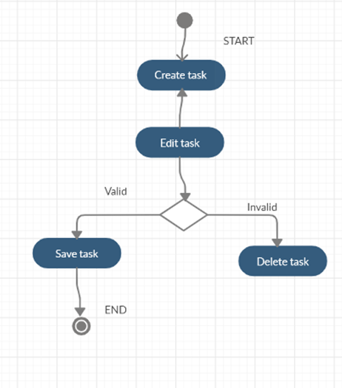
CHAPTER 3: RESULT OF TRAINNING COURSE
Activity Diagram
Create Task Diagram
C

Slide 9
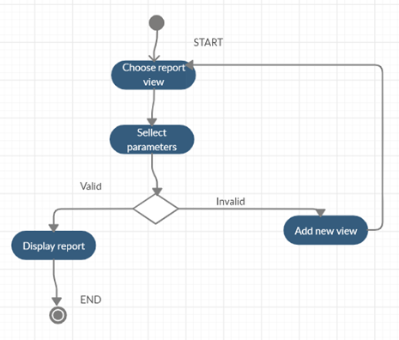
CHAPTER 3: RESULT OF TRAINNING COURSE
Activity Diagram
View Report Diagram
C

Slide 10
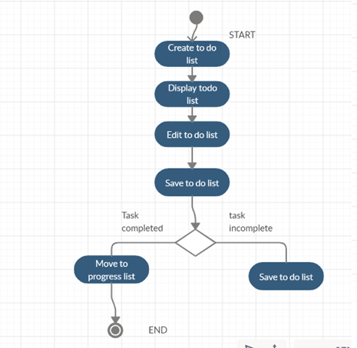
CHAPTER 3: RESULT OF TRAINNING COURSE
Activity Diagram
Create To-do List Diagram
C

Slide 11
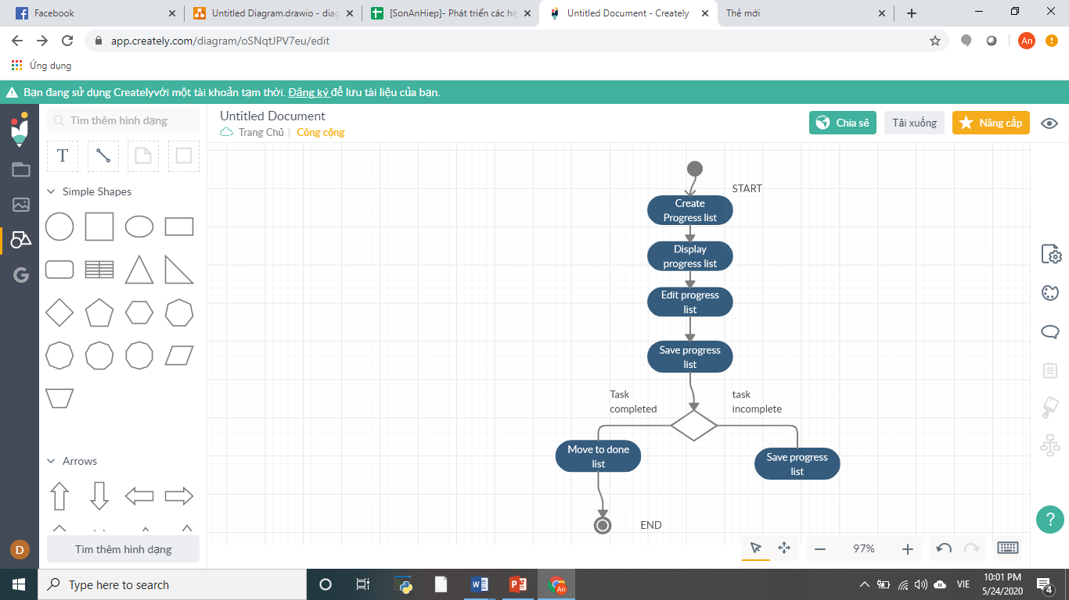
CHAPTER 3: RESULT OF TRAINNING COURSE
Activity Diagram
Creating Progress List Diagram
C

Slide 12
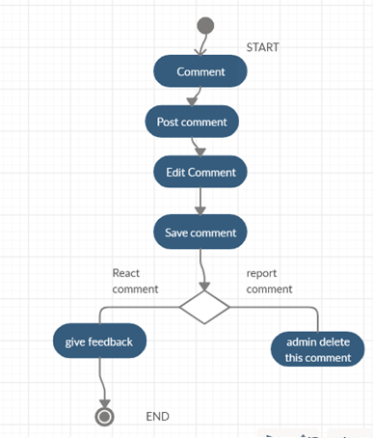
CHAPTER 3: RESULT OF TRAINNING COURSE
Activity Diagram
Comment Diagram
C

Slide 13
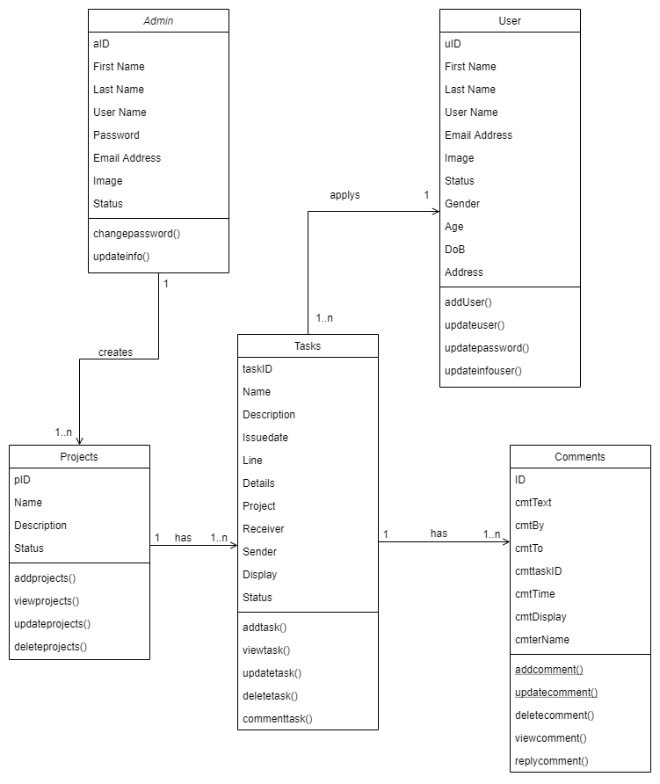
CHAPTER 3: RESULT OF TRAINNING COURSE
Class Diagram
C

Slide 14
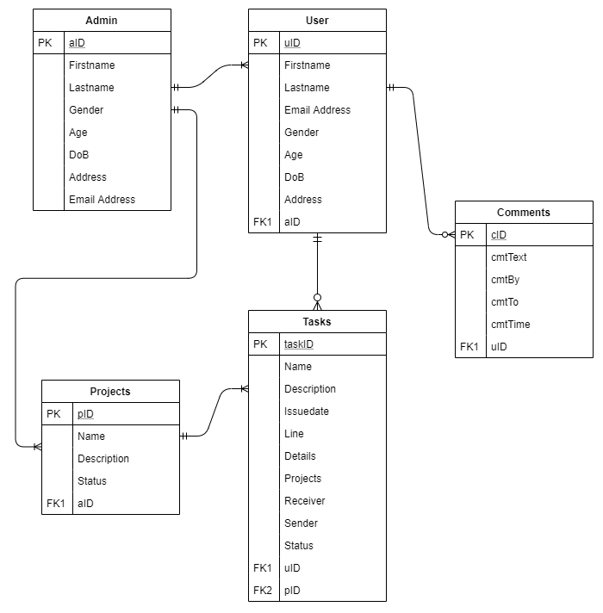
CHAPTER 3: RESULT OF TRAINNING COURSE
Entity Relationship Diagram (ERD)
C

Slide 15
CHAPTER 3: RESULT OF TRAINNING COURSE
DEMO
C

Slide 16
D
Conclusion

Slide 17
ADD TEXT
ADD TEXT
YOUR CONTENT
ADD TEXT
ADD TEXT
A
B
C

Slide 18
55%
65%
65%
55%
35%
TYPE YOUR TEXT
TYPE YOUR TEXT
TYPE YOUR TEXT
85%
25%
35%
35%
WRITE SOME TEXT HERE
TYPE YOUR TEXT
TYPE YOUR TEXT
TYPE YOUR TEXT

Slide 19


